Slide 1
Novi RF pasovi za javne mobilne komunikacije
Meta Pavšek Taškov
Informacije in stališča te predstavitve so informativnega značaja in nimajo regulatorne veljave
Ljubljana 26.5.2015

Slide 2
Uvod
Uvod
Stanje po dražbi 2014
WRC-15 (RSPG, RSC, CPG)
Priprave na javne dražbe novih frekvenčnih pasov po Evropi (D in F: 2015),
Pregled sprejetih EC, ECC dokumentov za nove frekvenčne pasove
HCM – TWG: Pobuda za skupni tekst za koordinacijske sporazume za nove frekvenčne pasove
Novi izzivi: PPDR, PMSE prenosne kamere za ENG/OB
Sklep

Slide 3
Rezultati dražbe 2 x 200 MHz parnega, 1 x 70 MHz neparnega

Slide 4
WRC -15 (stanje po CPG15-6 – Maj 2015)
AI_1.1: Novi frekvenčni pasovi za IMT:
ECP kategorije 1 (dodelitev za IMT):
1 427-1 518MHz, 3 400-3 800 MHz
ECP kategorije 3 (ni sprememb)
470 694 MHz, 1 300-1 350 MHz, 1350-1400 MHz, 1 518-1 525 MHz, 1 695-1 710 MHz, 2 025-2 110 MHz, 2 200-2 290 MHz, (2 700-2 900 MHz ?), 2 900-3 100 MHz, 3 300-3 400 MHz, 3800-4200 MHz, 4 400-4 500 MHz, 4 500-4 800 MHz, 4 800-4 990 MHz in 5 350-5 470 MHz, 5725-5850 MHz and 5925-6425 MHz
Ven iz liste kandidatov za ECP (Maj 2015):
FIN, S, UK:, 2 700-2 900 MHz
AI_1.2: 700 MHz (694 – 790 MHz) pas za IMT
AI_1.3: PPDR: za regijo 1

Slide 5
Mnenje RSPG WRC-15 o AI_1.1: RSPG15-593 FINAL – FEB 2015
AI_ 1.1: Navodilo EC članicam (poglavje 4, str. 9, 10): Member States should:
support no regulatory additional constraints to mobile service for the protection of aeronautical telemetry in the band 1429 – 1518 MHz,
also support, based on the RSPG Broadband Opinion, the worldwide identification of the following additional frequency bands for IMT:
1427 - 1518 MHz and
3400 - 3800 MHz (Already harmonised by EC Decision C(2014)2798)

Slide 6
Mnenje RSPG WRC-15 o AI_1.2 : RSPG15-593 FINAL – FEB 2015
A.I_1.2: 700 MHz pas - Member States should:
support 694 MHz as the lower edge for the allocation to the mobile service on a co-primary basis with the broadcasting service and identification for IMT in the 700 MHz band, while ensuring protection of the broadcasting service below 694 MHz;
ensure that no regulatory provisions in RR relevant to coexistence with broadcasting (co-channel, co-frequency and adjacent frequency) in addition to GE-06 agreement is adopted;
ensure equitable access between mobile service and aeronautical radionavigation services so as to facilitate the deployment of mobile services in all EU countries through appropriate regulatory provisions in the Radio Regulations. Cross-border coordination agreements should be aimed to be reached before WRC-15 for all Member States bordering countries outside the EU operating aeronautical radionavigation service.
ensure that there is no new provision which prohibits options for PMSE equipment

Slide 7
700 MHz pas – Sklep Radio Spectrum Policy Group (19.2.2015)
Member states should make the 700 MHz band available for " effective use" by electronic communications services " as early as possible" but latest by the end of 2020
Timing | 470-694 MHz band | 700 MHz band
Timing not defined |  | At EU level: Harmonised technical conditions for the use of the 700 MHz band for wireless broadband Deadlines for national authorisation processes and " effective" * use of the 700 MHz band laid down in a binding legislative measure
End 2017 |  | Agreements on cross-border coordination finalised
End 2020 (+ 2y) |  | 700 MHz band available for " effective use"* by electronic communications services
Until 2030 | Avaliable for DTT
Beyond 2030 | band available for downstream audiovisual content distribution

Slide 8
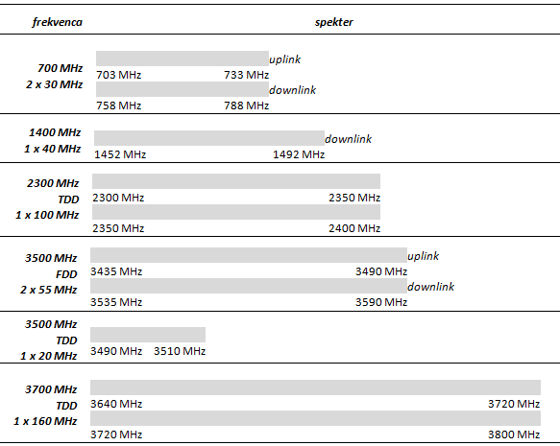
Prosti RF pasovi namenjeni za TRA_ECS

Slide 9
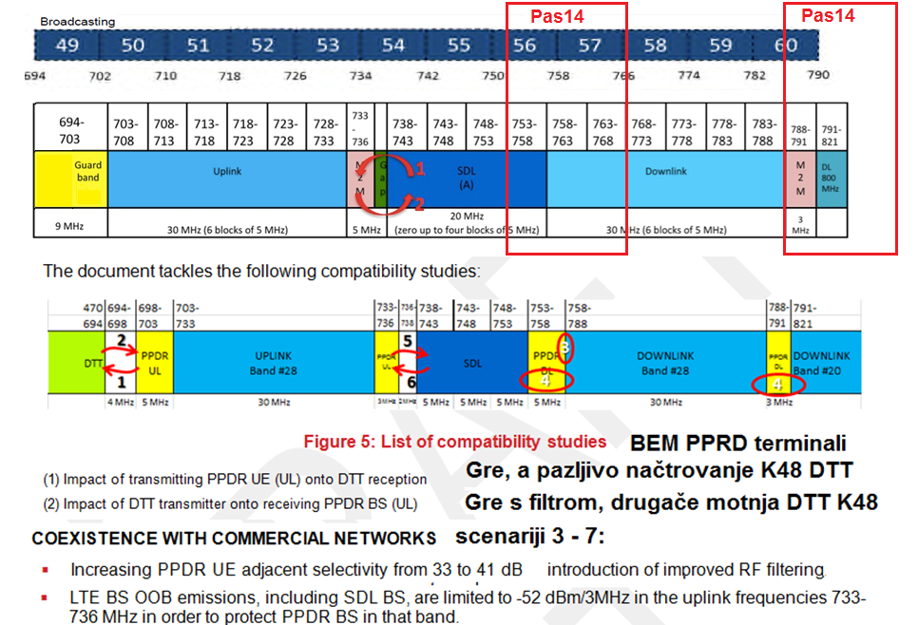
700 MHz – skupna rešitev za MFCN in PPDR – obveznost prioritizacije prometa

Slide 10
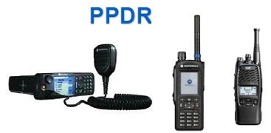
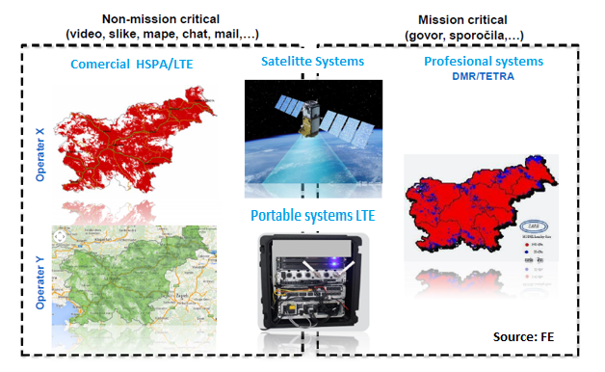
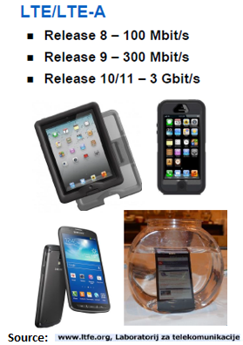
Ideas for implementation of 700 MHz band – possible sharing with BBPPRD
Commercial networks – much more development
Better coverage

Slide 11
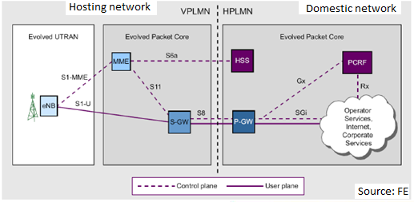
Roaming on commercial networks

Slide 12
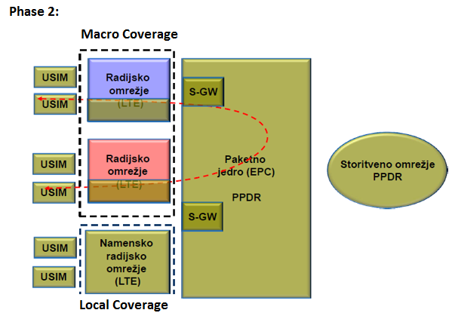
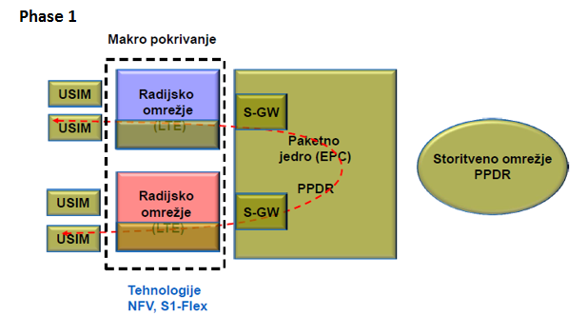
Shared network with commercial operators

Slide 13
Issues
Implemented features for PPDR should be standardized:
Push to talk P2T
Group calls
Direct mobile to mobile
Relay functions
QoS – traffic prioritization
Redundancy
Capacity
…

Slide 14
700 MHz pas
Frekven-čni pas | Vrsta dokumenta | Oznaka | Tip storitve | Naslov
700 | ECC Odločba | ECC/DEC/(15)01 | MFCN | Harmonizirani tehnični pogoji za MFCN v 700MHz pasu
700 | ECC Priporočilo | draft ECC/REC/(15)01 | MCFN | Čezmejna koordinacija
700 | CEPT poročilo | CEPT Report 53 | MFCN | Harmonizirani tehnični pogoji za MFCN v 700MHz pasu – mandat EU
700 | ECC Poročilo | Draft ECC Report 218 WGFM | PPDR | Harmonizirani spekter za uporabo širokopasovnega PPDR v EU
700 | ECC Poročilo | Draft ECC Report SE7 | PPDR | Kompatibilnost BBPPDR v 700 MHz pasu z ostalimi storitvami

Slide 15
Pasovi 1400 MHz, 1800 MHz, 2100 MHZ
Frekven-čni pas | Vrsta dokumenta | Oznaka | Tip storitve | Naslov
1400 | ECC Odločba | ECC Decision (13)03 | MFCN | Harmonizirani tehnični pogoji za MFCN v 1400MHz pasu
1400 | ECC Priporočilo | ECC/REC/(15)01 | MFCN | Čezmejna koordinacija
1400 | CEPT poročilo | CEPT Report 54 | MFCN | Harmonizirani tehnični pogoji za MFCN v 1400MHz pasu – mandat EU
1400 | ECC Poročilo | ECC Report 227 | MFCN | Kompatibilnostne študije za MFCN
1400 | ECC Poročilo | ECC Report 202 | MFCN | Omejitve sevanj izven pasu za MFCN
1400 | ECC Poročilo | ECC Report 188 | MFCN | Harmonizirana uporaba pasu 1400 MHz v CEPT

Slide 16
Pas 1400 MHz
Frekven-čni pas | Vrsta dokumenta | Oznaka | Tip storitve | Naslov
1400 | ECC Odločba | ECC Decision (13)03 | MFCN | Harmonizirani tehnični pogoji za MFCN v 1400MHz pasu
1400 | ECC Priporočilo | ECC/REC/(15)01 | MFCN | Čezmejna koordinacija
1400 | CEPT poročilo | CEPT Report 54 | MFCN | Harmonizirani tehnični pogoji za MFCN v 1400MHz pasu – mandat EU
1400 | ECC Poročilo | ECC Report 227 | MFCN | Kompatibilnostne študije za MFCN
1400 | ECC Poročilo | ECC Report 202 | MFCN | Omejitve sevanj izven pasu za MFCN
1400 | ECC Poročilo | ECC Report 188 | MFCN | Harmonizirana uporaba pasu 1400 MHz v CEPT

Slide 17
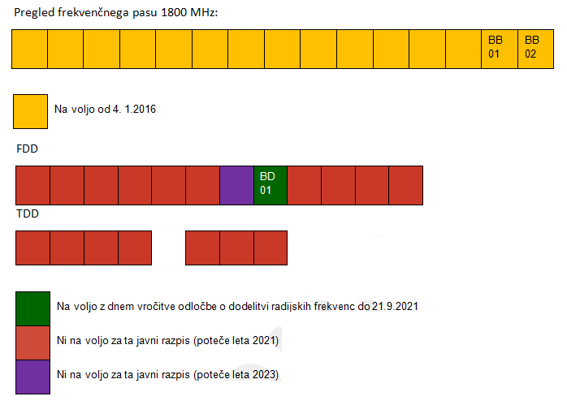
Nedodeljeni spekter v pasovih 1800 MHz, 2100 MHz

Slide 18
Pas 2300 MHz
Frekvpas | Vrsta dokumenta | Oznaka | Stori-tev | Naslov
2300 | ECC Odločba | ECC/DEC/(14)02 | MFCN | Harmoniz. tehnični pogoji za MFCN v 2300MHz pasu
2300 | ECC Priporočilo | draft ECC/REC/(15)04 | MFCN | Souporaba pasu 2300-2400 MHz med MFCN in PMSE
2300 | ECC priporočilo | ECC/REC/(14)04 | MFCN | Čezmejna koordinacija
2300 | CEPT poročilo | CEPT Report 58 | MFCN,PMSE | Souporaba pasu 2300-2400 MHz med WBB in PMSE
2300 | CEPT poročilo | CEPT Report 56 | MFCN | Souporaba pasu 2300 MHz med WBB in obstoječimi primarnimi storitvami
2300 | CEPT poročilo | CEPT Report 55 | MFCN | Harmonizirani tehnični pogoji za WBB v 2300MHz
2300 | ECC Poročilo | ECC Report 205 | MFCN | Licensed Shared Access (LSA)
2300 | ECC Poročilo | ECC Report 216 | MFCN | Praktična navodila za sinhronizacijo TDD omrežij
2300 | ECC Poročilo | ECC Report 172 | MFCN | Uporaba WBB (Broadband Wireless Systems) v pasu 2300-2400 MHz
2300 | ECC Poročilo | ECC Report 219 | PMSE | Karakteristike PMSE digitalnih video linkov

Slide 19
Pasova 3500 in 3700 MHz
Vrsta dokumenta | Oznaka | Stori-tev | Naslov
EC odločba | 2014/276/EU | MFCN | Harmonizirana uporaba pasu 3 400-3 800 MHz za TRA-ECS
ECC Odločba | ECC/DEC/(11)06 | MFCN | Harmonizirani kanalski raster za MFCN v pasovih 3400-3600 MHz in 3600-3800 MHz
ECC Priporočilo | ECC/REC/(15)01 | MFCN | Čezmejna koordinacija
CEPT poročilo | CEPT Report 49 | MFCN | Harmonizirana uporaba pasu 3400-3800 MHz za MFCN
ECC Poročilo | ECC Report 216 | MFCN | Praktična navodila za sinhronizacijo TDD omrežij
ECC Poročilo | ECC Report 203 | MFCN | Tehnični pogoji uporabe za MFCN, vključno z IMT v pasovih 3400-3600 MHz in 3600-3800 MHz

Slide 20
Plan za naprej – nacionalni razpis za frekvence 700/1400/1800/2300/3500/3700 MHZ
3G5
3G7
FDD (3425-3500 MHz/ 3525-3600 MHz)
TDD (3490 – 3510 MHz)
TDD (3640 – 3800 MHz)

Slide 21
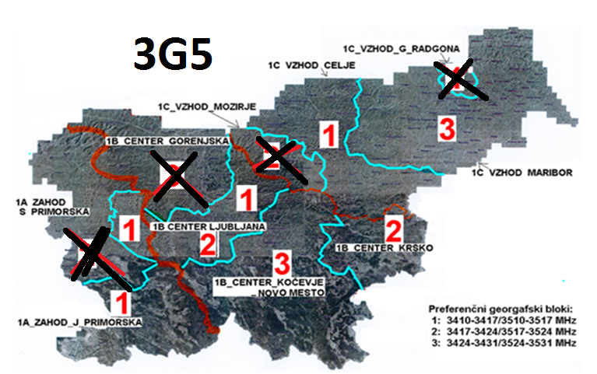
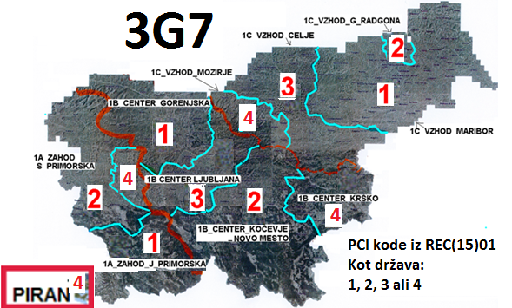
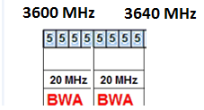
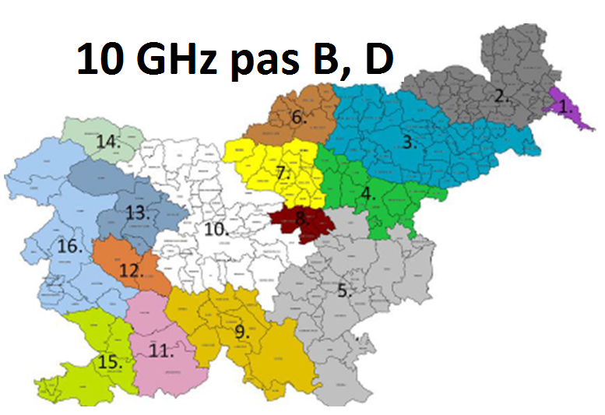
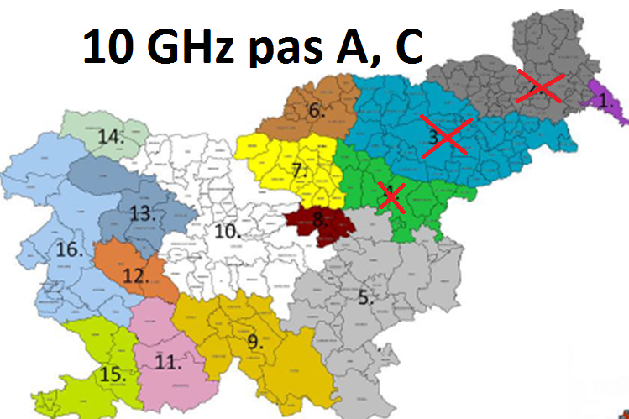
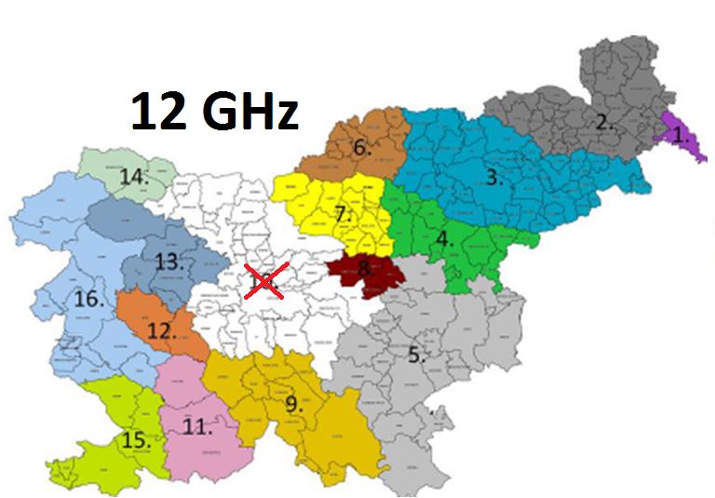
Plan za naprej – lokalni razpis za frekvence 3.5/3.7/10/12 GHz – konec 2015 –samo v info - ni predmet posveta

Slide 22
HCM – TWG: Pobuda za skupni tekst za koordinacijske sporazume
17.3.2015 Bukarešta: HCM – TWG: Pobuda Slovenije za skupni tekst za koordinacijske sporazume za nove frekvenčne pasove 700/1400/2300/3500/3700 MHz ter predlog, kako narediti prehod iz obstoječih 3500 MHz sporazumov za FWA (7 MHz raster -> 5 MHz raster)
18.-19.3 2015 Bukarešta: HCM–SWG_FS: prehod na 3500 MHz
24. – 26.3.2015 Luxemburg: HCM–SWG_MS: Pobuda Slovenije za skupni tekst za koordinacijske sporazume za nove frekvenčne pasove 700/1400/2300/3500/3700 MHz
Preliminarni odzivi: DA, od variante samo kot osnova, ki jo je možno spreminjati in vključevati v parcialne bilateralne sporazume, do možnoti skupnega sporazuma vseh 17 članic
19.-20.5. 2015, Bled : Delavnica EU regulatorjev
Nemci in Avstrijci pripravljajo nekaj podobnega, Hrvaška je zainteresirana, Slovenija pošlje predlog teksta sosednjim državam

Slide 23
Hvala za pozornost
Vprašanja???

